Slide 1
WS Outreach
Service-Learning
“Let’s Carry the Message”
Notes:
Let’s Carry the message

Slide 2
INCREASE AWARENESS BY INFORMING FAMILIES AND PROFESSIONALS THAT HELP IS AVAILABLE
CARRY THE MESSAGE OF HOPE
SHARE WHAT
NAR-ANON
MEANS TO US
LINK INDIVIDUALS SEEKING HELP WITH NFG MEMBERS WHO SHARE THEIR EXPERIENCE, STRENGTH, AND HOPE
ENCOURAGE MEETING ATTENDANCE
SHARE OUTREACH LITERATURE
Notes:
Should we us NFG?

Slide 3
A.
CARRY THE MESSAGE TO
OTHERS
WHAT PRINCIPLES GUIDE OUTREACH?
STEP 12 – Having had a spiritual awakening as a result of these steps, we tried to carry this message to others, and to practice these principles in all our affairs.

Slide 4
B.
COOPERATION, NOT
AFFILIATION
WHAT PRINCIPLES GUIDE OUTREACH?
TRADITION 3 – The relatives of addicts, when gathered for mutual aid, may call themselves a Nar-Anon Family Group, provided that as a group, they have no other affiliation. The only requirement for membership is that there be a problem of addiction in a relative or friend.

Slide 5
WHAT PRINCIPLES GUIDE OUTREACH?
C.
HELPING FAMILIES OF ADDICTS
TRADITION 5 – Each Nar-Anon Family Group has but one purpose; to help families of addicts. We do this by practicing the Twelve Steps of Nar-Anon, encouraging and understanding our addicted relatives, and by welcoming and giving comfort to families of addicts.

Slide 6
WHAT PRINCIPLES GUIDE OUTREACH?
D.
DECLINE OUTSIDE
CONTRIBUTIONS
TRADITION 7 – Every group ought to be self- supporting, declining outside contributions.

Slide 7
WHO CAN DO OUTREACH?
MEMBERS
WITH AN UNDERSTANDING
OF NAR-ANON PRINCIPLES
NAR-ANON
FAMILY
GROUPS
OUTREACH COMMITTEES

Slide 8
WHERE CAN OUTREACH HAPPEN?
A. Community and Health Fairs
B. Drug awareness prevention events
C. Hospitals and Treatment facilities
D. Sharing of materials in community locations
E. Police, prison, jail, and court
F. Schools and Places of Worship

Slide 9
HOW CAN OUTREACH BE CONDUCTED?
INFORMATION BOOTHS AT COMMUNITY EVENTS
ONGOING DIGITAL EFFORTS
OUTREACH PRESENTATION
AT
TREATMENT CENTERS
SHARING
LITERATURE
AND
POSTERS
PERSON
TO
PERSON
SHARING

Slide 10
RESOURCES & TOOLS
PUBLIC SERVICE ANNOUNCEMENTS
CHECKLIST FOR AN OUTREACH BOOTH
OUTREACH LETTERS FOR INDIVIDUALS AND PROFESSIONALS
White Literature - 400 pieces
What is Nar-Anon? (50)
Nar-Anon Offers Hope (150) Open Letter (100)
To The Concerned Family (100)
Notes:
Should we us NFG?

Slide 11
SUGGESTED TALKING POINTS
1. What is Nar-Anon?
2. How did you discover Nar-Anon?
3. How did you feel at your first meeting?
4. How has Nar-Anon been helpful?
5. What tools do you use to cope?
6. Why focus on yourself when a loved one is suffering?
7. How do you let go of control?
8. Give an example of enabling behavior.
9. Give an example of denial of addiction.
10. How did you come out of denial?

Slide 12
GUIDELINES FOR CONTACTING PROFESSIONALS
WHO – Give your first name (last name if you are comfortable)
WHAT – Nar-Anon – tell what it is
WHY – Give reason for the call - i.e. drop off literature, schedule a presentation, ask for an audio/video PSA broadcast, etc.
WHEN – Confirm a time to drop off literature, make a presentation or schedule broadcast audio/video PSA
WHERE – Confirm location of literature drop off, presentation or audio/video file transfer
HOW – Clarify how the literature drop off, presentation or file transfer happens

Slide 13
OUTREACH PLAN OUTLINE
WHAT – define the specific outreach event (town hall meeting, facility visit, etc.)
WHEN – specific date and time for the event
WHERE – event location with directions
WHO – Target audience (who will receive the message)
Nar-Anon team ( who will give the message)
HOW – how will we participate in the event (display, literature, signage, handouts, etc.)

Slide 14
WS Website Outreach Page
http//:www.nar-anon.org/outreach
Got A Question?
Email outreach@nar-anon.org
We Want To Connect
With You!

Slide 15
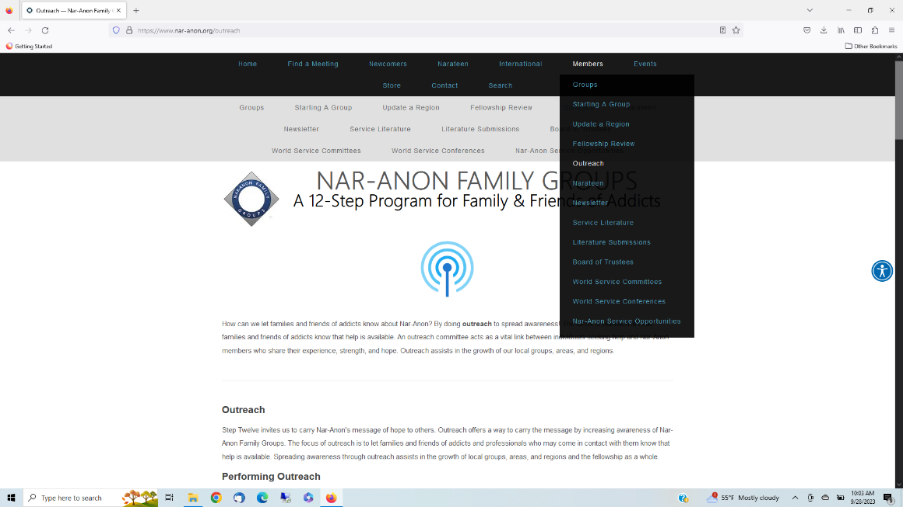
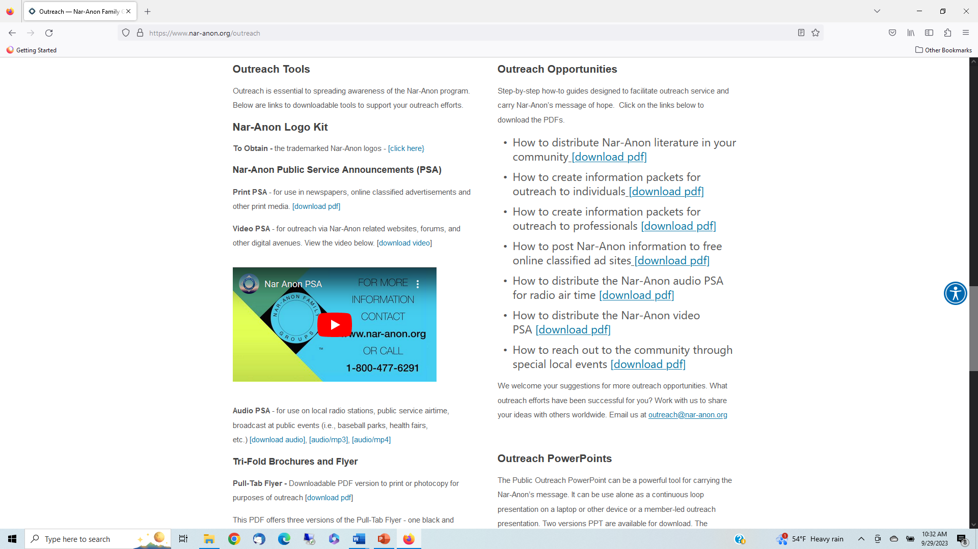
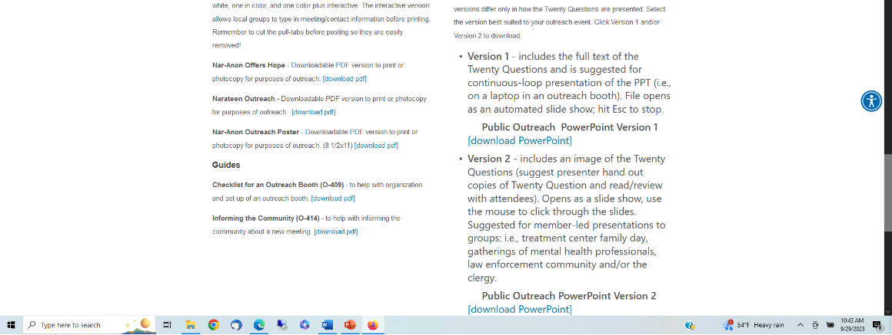

Slide 16
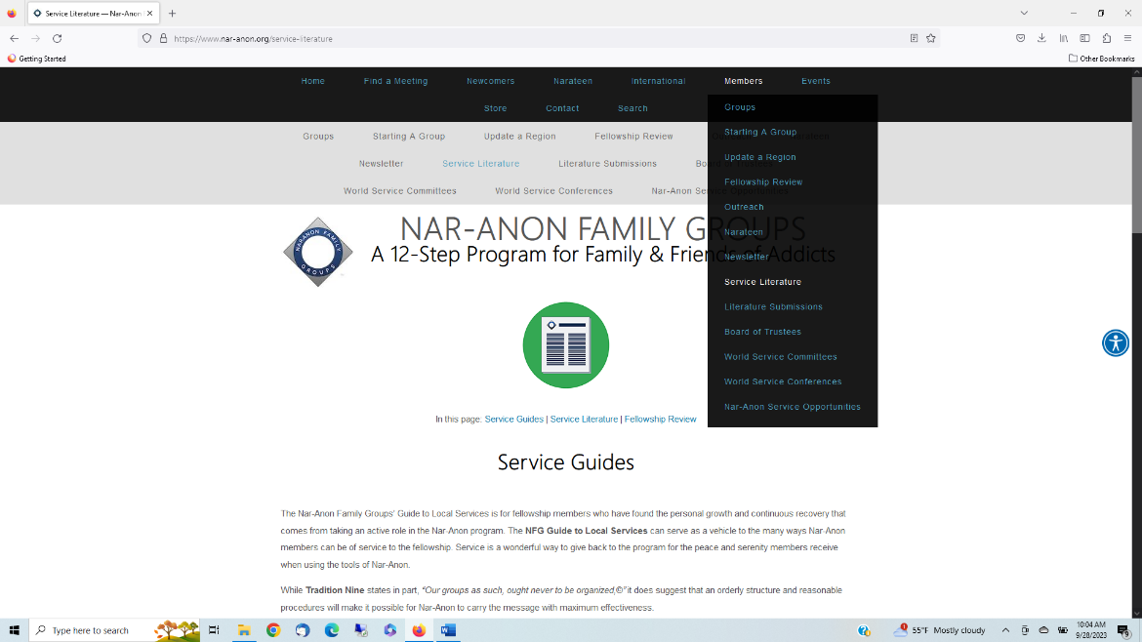
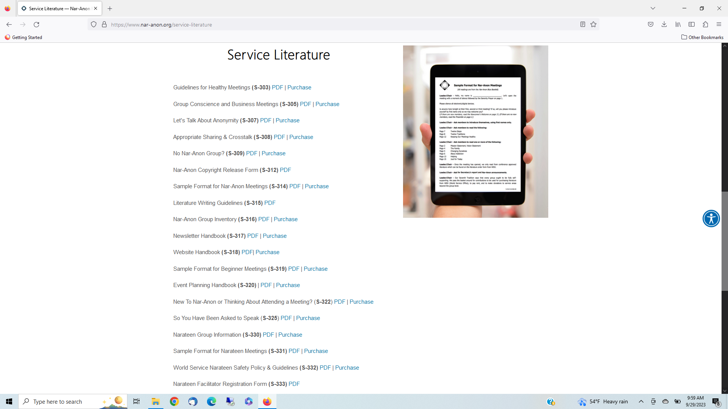
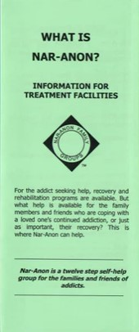

Slide 17
